Slide 1
Capstone Engagement
Assessment, Analysis, and Hardening of a Vulnerable System

Slide 2
Table of Contents
This document contains the following sections:
01
Network Topology
02
Red Team: Security Assessment
03
Blue Team: Log Analysis and Attack Characterization
Hardening: Proposed Alarms and Mitigation Strategies
04

Slide 3
Network Topology
‹#›

Slide 4
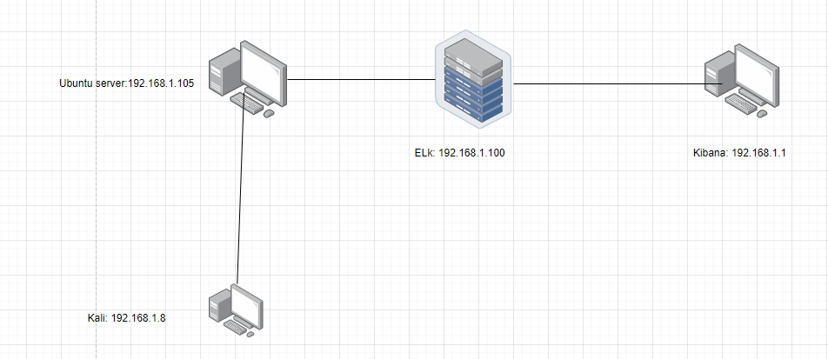
Network Topology
Network
Address Range: 192.168.1.1
Netmask:255.255.255.0
Gateway: /24
Machines
IPv4: 192.168.1.8
OS: linux
Hostname: kali
IPv4: 192.168.1.1
OS: windows
Hostname: ELK
IPv4: 192.168.1.1
OS: Windows
Hostname: ELK
IPv4: 192.168.1.100
OS: Ubuntu server
Hostname: capstone

Slide 5

Red Team
Security Assessment
‹#›

Slide 6
Recon: Describing the Target
Nmap identified the following hosts on the network:
Hostname | IP Address | Role on Network
kibana | 192.168.1.1 | To access kibana to logs
elk | 192.168.1.100 | To be able to pull logs from ubuntu server
Ubuntu server | 192.168.1.105 | Vulnerable server on corporate network
Kali | 192.168.1.8 | Run attacks on Ubuntu server

Slide 7
Vulnerability Assessment
The assessment uncovered the following critical vulnerabilities in the target:
Vulnerability | Description | Impact
Use the CVE number if it exists. Otherwise, use the common name. | Describe the vulnerability. | Describe what this vulnerability allows the attacker to do.
Sensitive data exposure | Sensitive data is exposure | Allows attacker to gain information about date and access it
Brute force | Allows software to run a brute force attack | Allows attacker to obtain credentials for shares and login
Unrestricted file upload | Allows files upload | Allows attacker to run code and run meterpreter sessions

Slide 8
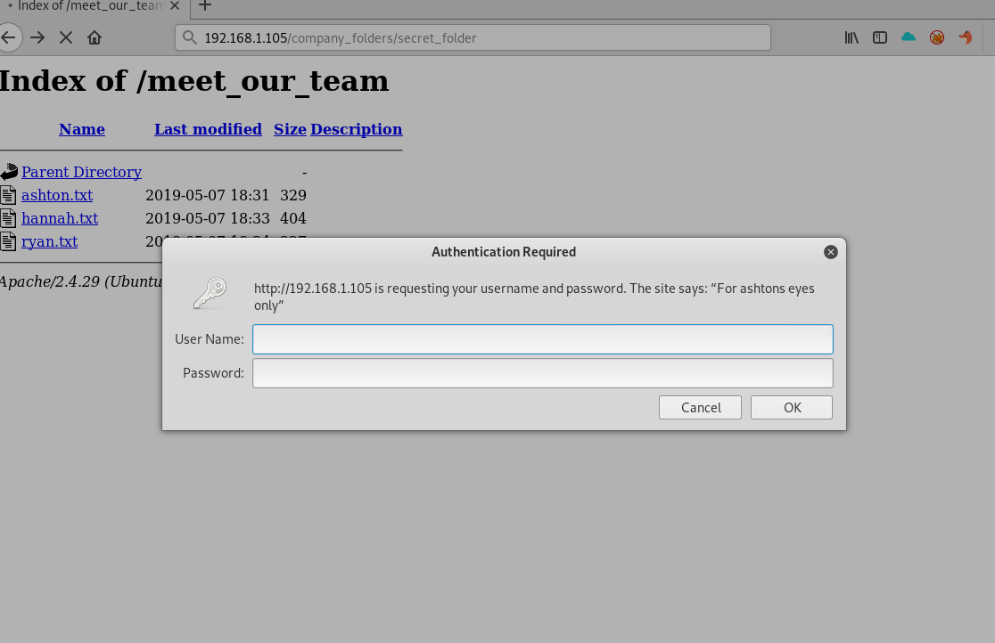
Exploitation: [Sensitive data exposure]
01
02
03
Tools & Processes
How did you exploit the vulnerability? Which tool (Nmap, etc.) or techniques (XSS, etc.) did you use?
Firefox to use company website
Achievements
What did the exploit achieve? For example: Did it grant you a user shell, root access, etc.?
Used Root access

Slide 9
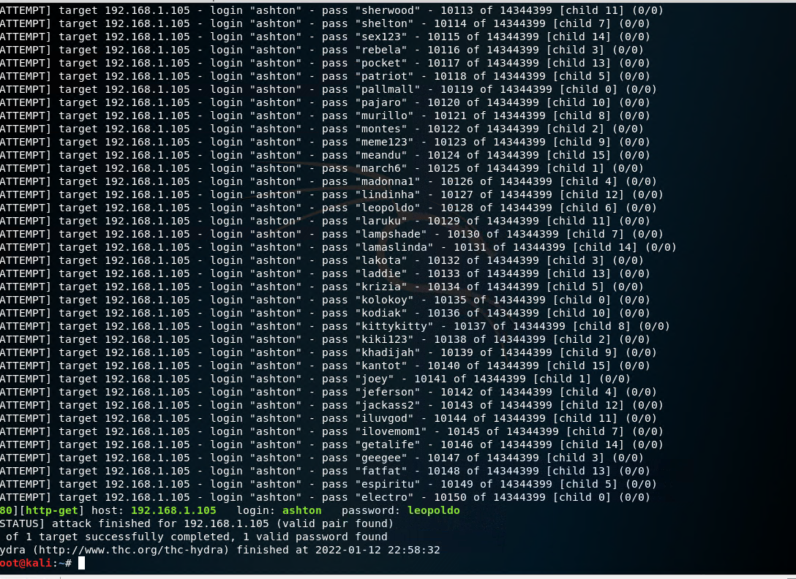
Exploitation: [Brute Force]
01
02
03
Tools & Processes
How did you exploit the vulnerability? Which tool (Nmap, etc.) or techniques (XSS, etc.) did you use?
Hydra
Achievements
What did the exploit achieve? For example: Did it grant you a user shell, root access, etc.?
Being able to gain credentials Brute force
[INSERT: screenshot or command output illustrating the exploit.]

Slide 10
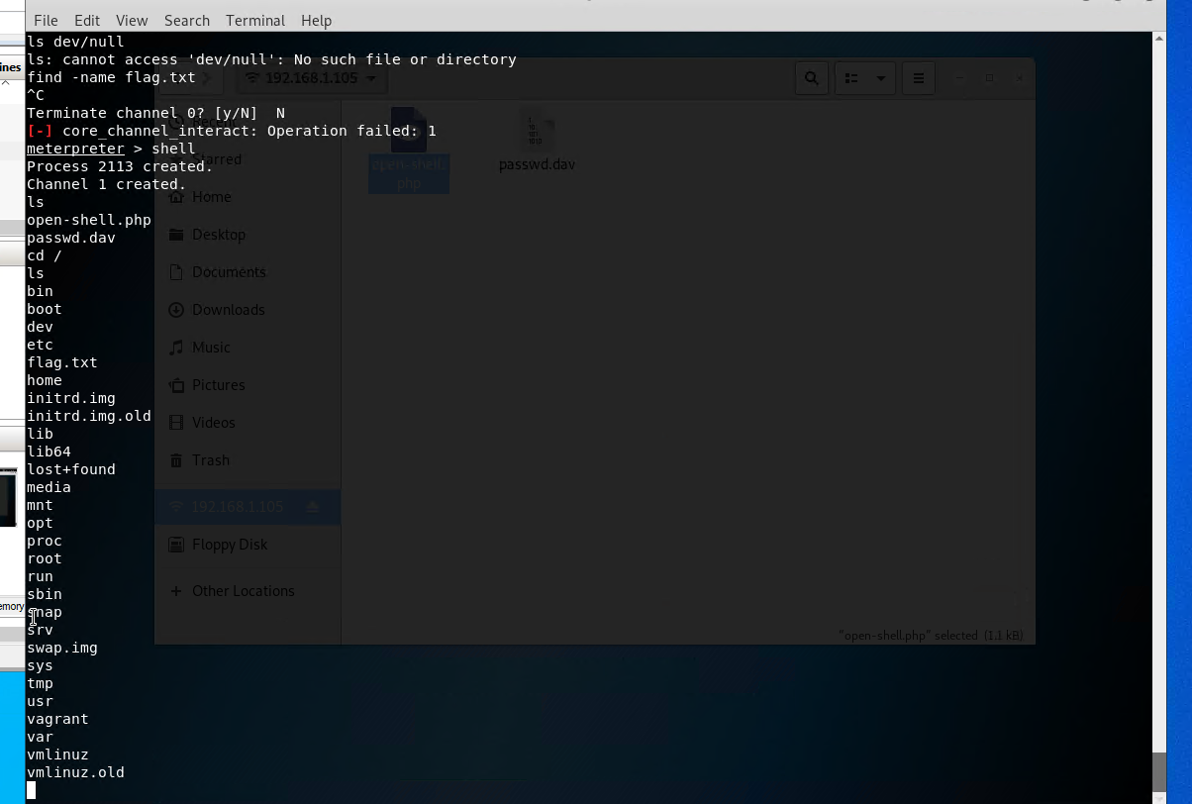
Exploitation: [Unauthorized file upload]
01
02
03
Tools & Processes
How did you exploit the vulnerability? Which tool (Nmap, etc.) or techniques (XSS, etc.) did you use?
Msf to create a php reverse shell
Achievements
What did the exploit achieve? For example: Did it grant you a user shell, root access, etc.?
To gain access to system
[INSERT: screenshot or command output illustrating the exploit.]

Slide 11

Blue Team
Log Analysis and Attack Characterization
‹#›

Slide 12

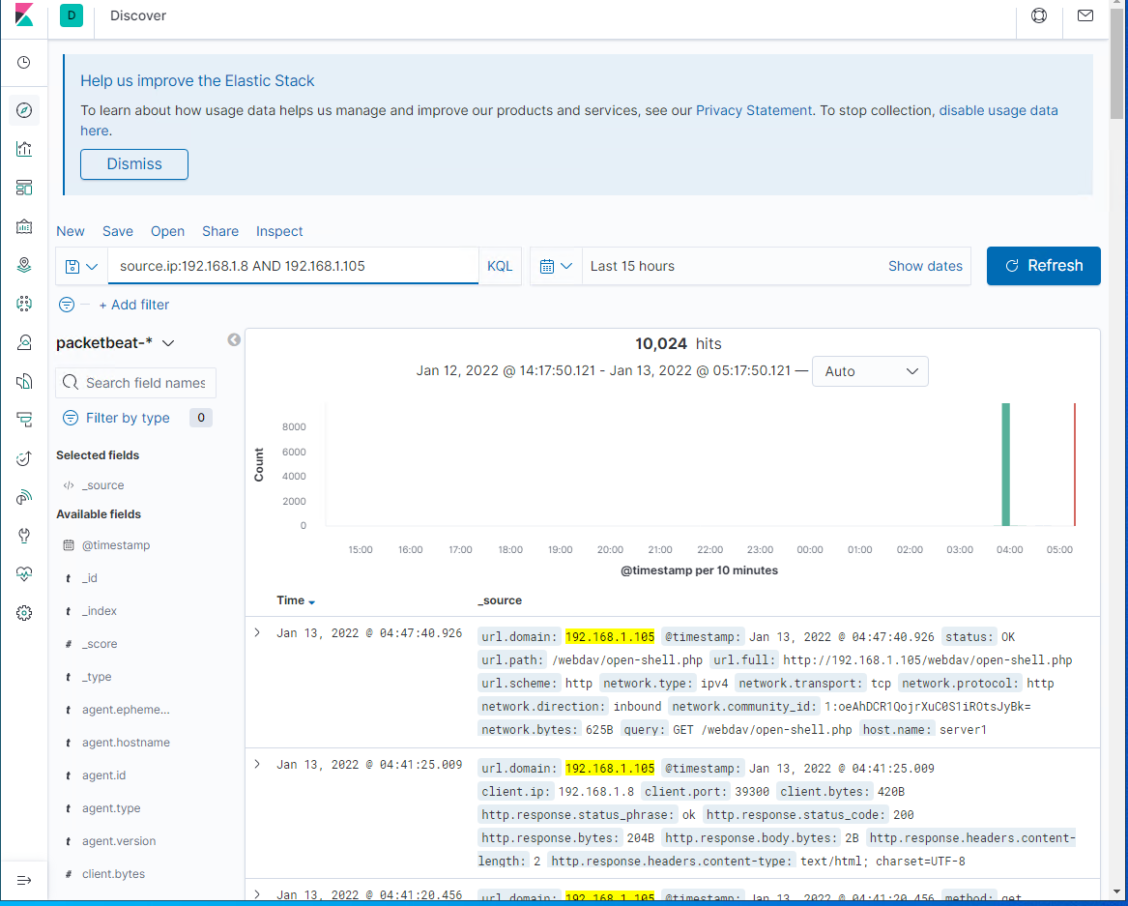
Analysis: Identifying the Port Scan
Answer the following questions in bullet points under the screenshot if space allows. Otherwise, add the answers to speaker notes.
What time did the port scan occur? 4am
How many packets were sent, and from which IP? 10,024
What indicates that this was a port scan? Http 200
[Insert Here]
Include a screenshot of Kibana logs depicting the port scan.

Slide 13
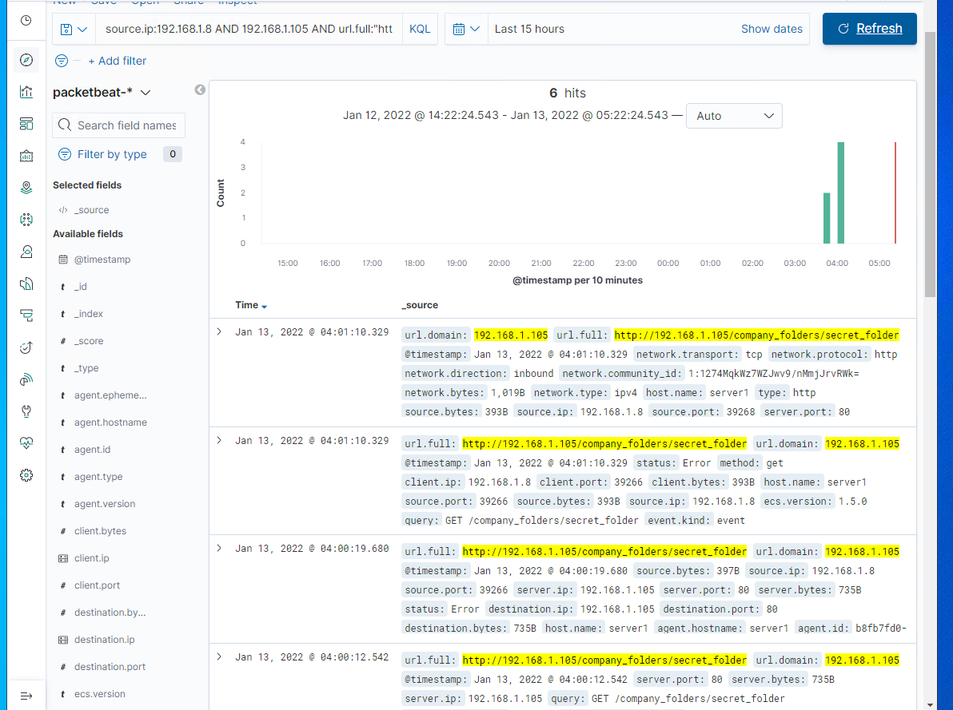
Analysis: Finding the Request for the Hidden Directory
Answer the following questions in bullet points under the screenshot if space allows. Otherwise, add the answers to speaker notes.
What time did the request occur? How many requests were made? 6
Which files were requested? What did they contain? Hash, password for web dev
[Insert Here]
Include a screenshot of Kibana logs depicting the request for the hidden directory.

Slide 14
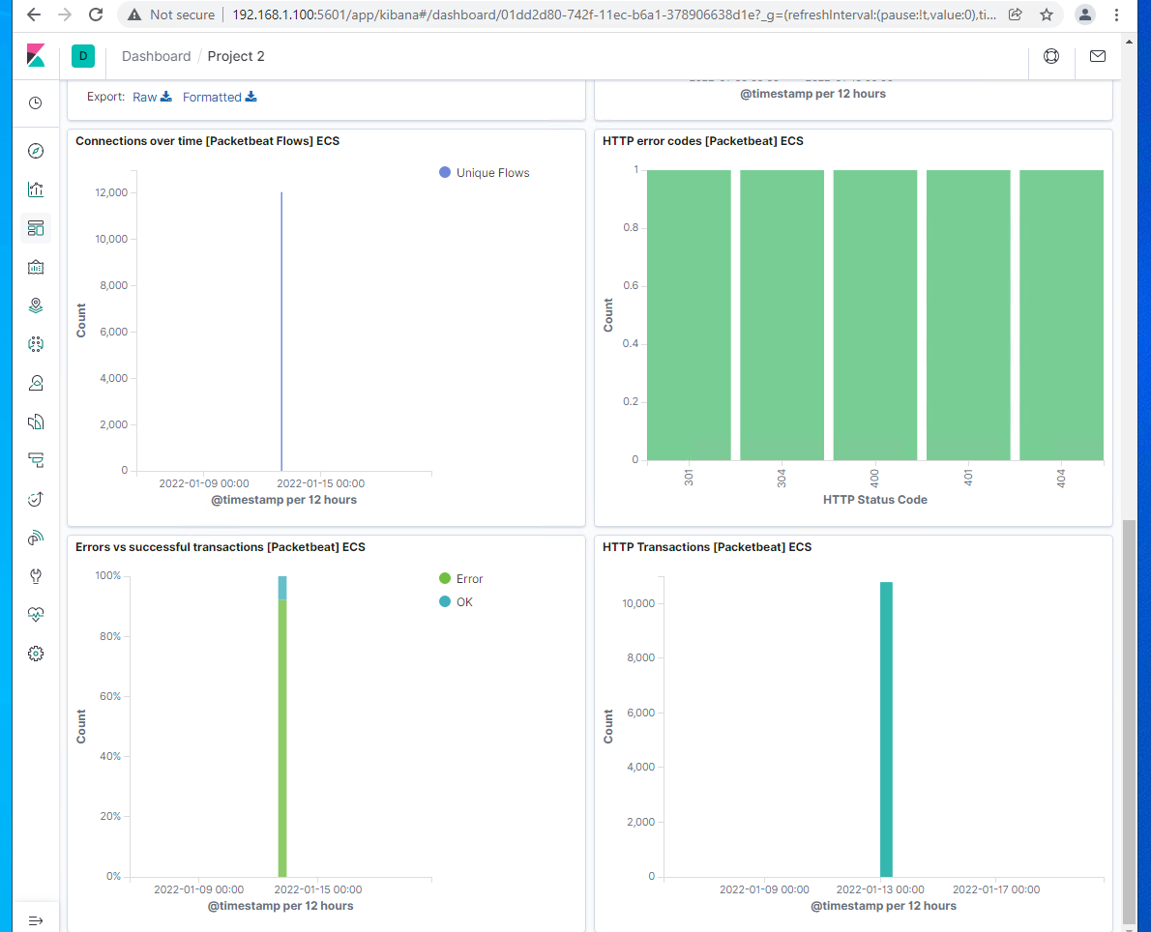
Analysis: Uncovering the Brute Force Attack
Answer the following questions in bullet points under the screenshot if space allows. Otherwise, add the answers to speaker notes.
How many requests were made in the attack? 9,969
How many requests had been made before the attacker discovered the password? 9,969
[Insert Here]
Include a screenshot of Kibana logs depicting the brute force attack.

Slide 15
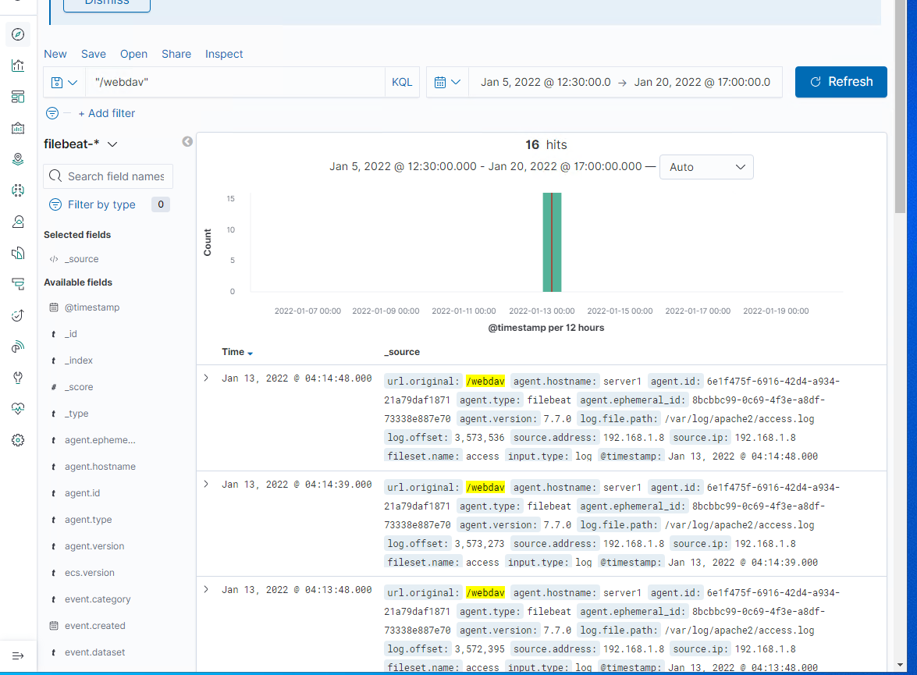
Analysis: Finding the WebDAV Connection
Answer the following questions in bullet points under the screenshot if space allows. Otherwise, add the answers to speaker notes.
How many requests were made to this directory 16 requests
Which files were requested? Html , password file, shell file
[Insert Here]
Add a screenshot of Kibana logs depicting the WebDAV connection.

Slide 16
Blue Team
Proposed Alarms and Mitigation Strategies
‹#›

Slide 17
Mitigation: Blocking the Port Scan
What kind of alarm can be set to detect future port scans?
401 error
What threshold would you set to activate this alarm?
Every 500 scans
What configurations can be set on the host to mitigate port scans?
Conifg firewall
Describe the solution. If possible, provide required command lines.
To protect the system

Slide 18
Mitigation: Finding the Request for the Hidden Directory
What kind of alarm can be set to detect future unauthorized access?
Attempt to access directory
What threshold would you set to activate this alarm?
300 attempts
What configuration can be set on the host to block unwanted access?
encryption
Describe the solution. If possible, provide required command lines.
Don’t use information on open networks

Slide 19
Mitigation: Preventing Brute Force Attacks
What kind of alarm can be set to detect future brute force attacks?
Detect 401 unauthorized attacks
What threshold would you set to activate this alarm?
300 attempts
What configuration can be set on the host to block brute force attacks?
Log out policy, whitelisting ip
Describe the solution. If possible, provide the required command line(s).
Stronger password

Slide 20
Mitigation: Detecting the WebDAV Connection
What kind of alarm can be set to detect future access to this directory?
Tent login or unknown logins
What threshold would you set to activate this alarm?
Whitelisting ips
What configuration can be set on the host to control access?
Change password every 30 days
Describe the solution. If possible, provide the required command line(s).
Protect simple passwords from being breached

Slide 21
Mitigation: Identifying Reverse Shell Uploads
What kind of alarm can be set to detect future file uploads?
Allure caches outside of port
What threshold would you set to activate this alarm?
30 attempts
What configuration can be set on the host to block file uploads?
Listing ip, blocking ports
Describe the solution. If possible, provide the required command line.
Strengthen the protection

